Slide 1


Team 15: Rogue Chess App Bi-Weekly Update 4 Jose Herrera, Travis Head Sponsor: Pranav Dhulipala TA: Eric Robles
Notes:
Michelle

Slide 2
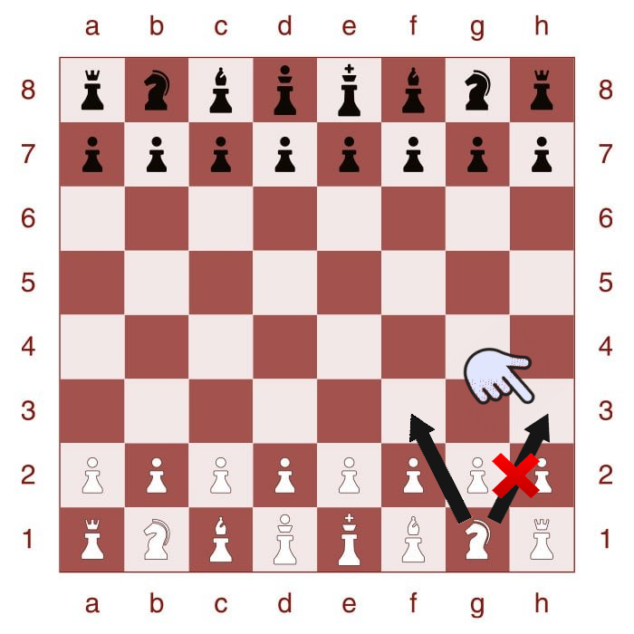
Project Summary
Problem: There are many variations of the game of chess; however, after a while it can be predictable or lack of excitement.
Proposed Solution: Develop an app of a new chess variation with a randomization factor for Android products.
Develop an AI for Single Player Mode
Create a randomization factor
Create a User Interface for the players interaction
Highlighted boxes to assist the player in making the next move legally
Create different difficulty levels
Upload the contents to the cloud
Notes:
Kyle

Slide 3
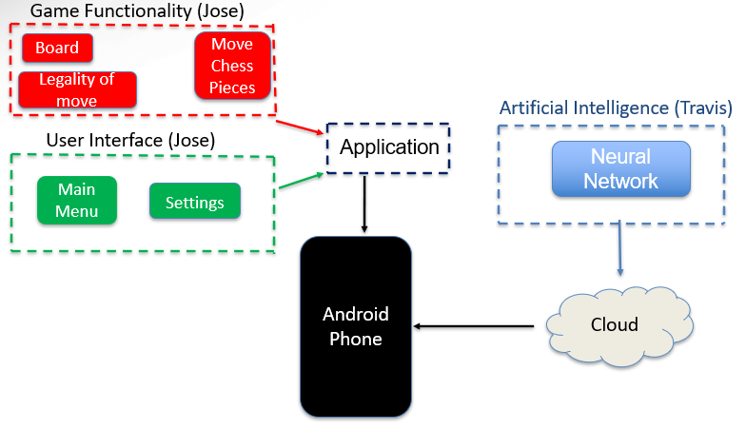
Project Overview
Notes:
Eric

Slide 4
Project Timeline
Subsystem Corrections (to complete by 9/19) | Research for Server Integration (completed 9/12) | Connection of Game App to Server (to complete by 9/20) | Connection of AI & App to Server (to complete by 9/26) | Final Integration (to complete by 10/17) | System Test & Optimization (to complete by 10/31) | Validation (to complete by 11/16) | Demo and Report (to complete by 11/28)
__ - Completed
__ - In Progress
- Not Started
Notes:
Eric

Slide 5
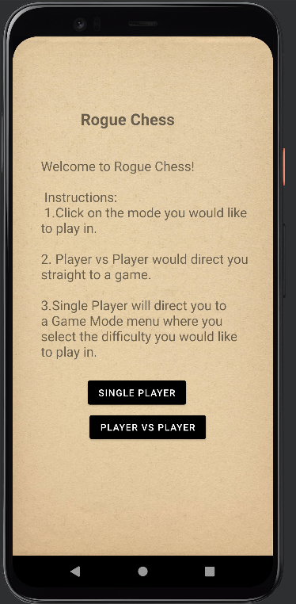
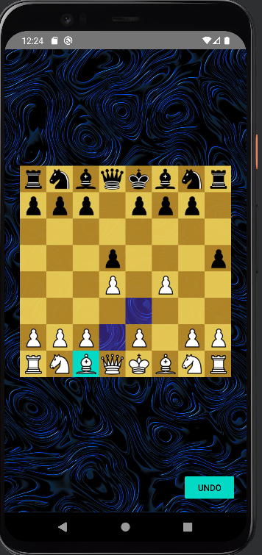
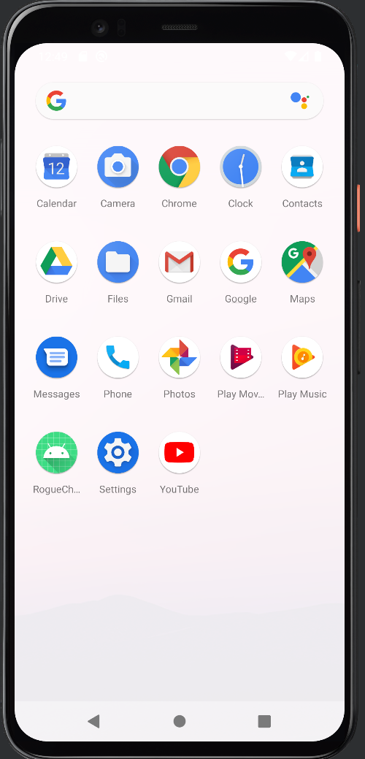
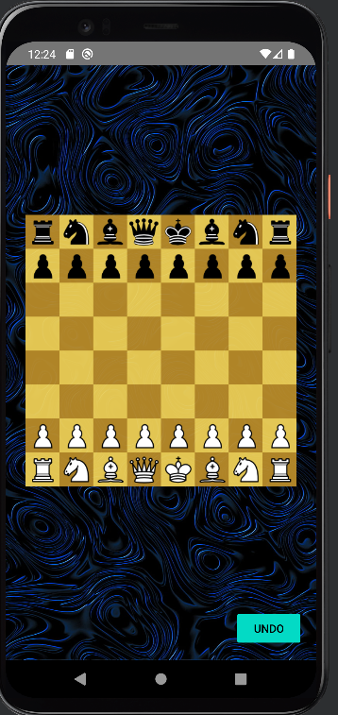
Integrated System Diagram
Select Game Mode
AI or second player move
App is installed
Open App
Player Makes move
When Game Over
Notes:
Eric

Slide 6
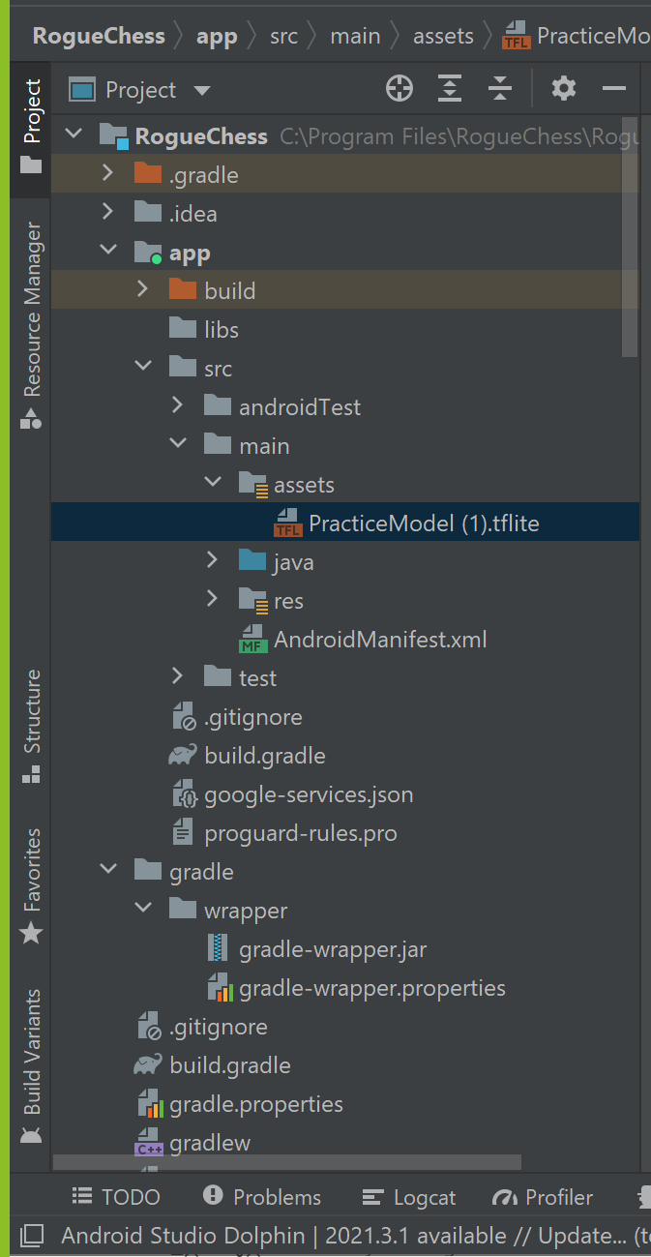
Integration
Travis Head and Jose Herrera

Slide 7
App Integration Progress
Jose Herrera
Accomplishments since last presentation 7 hrs of effort | Ongoing progress/problems and plans until the next presentation
Created Files for A.I. installation Researched on metadata and new TensorFlow integration | Finalize integration with A.I. to call movements and visualize in app Get metadata to work (stretch)

Slide 8
A.I. Integration Progress Travis Head
Accomplishments since last presentation 8 hrs of effort | Ongoing progress/problems and plans until the next presentation
Researched RNN integration in Android app A.I. Model successfully allocated in app | Ongoing work to produce chess piece movement in app

Slide 9
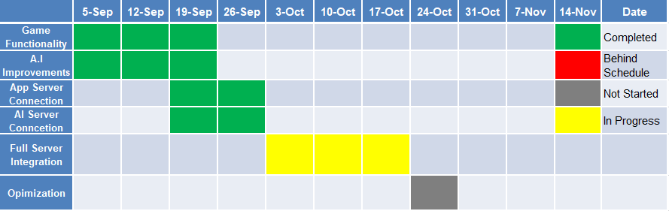
Execution Timeline
Notes:
Michelle

Slide 10
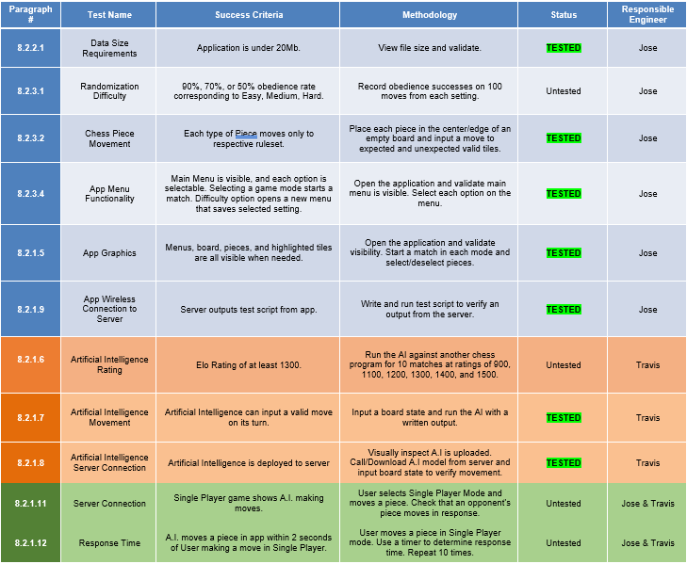
Execution & Plan
Notes:
Michelle

Slide 11
Questions?

